Slide 1
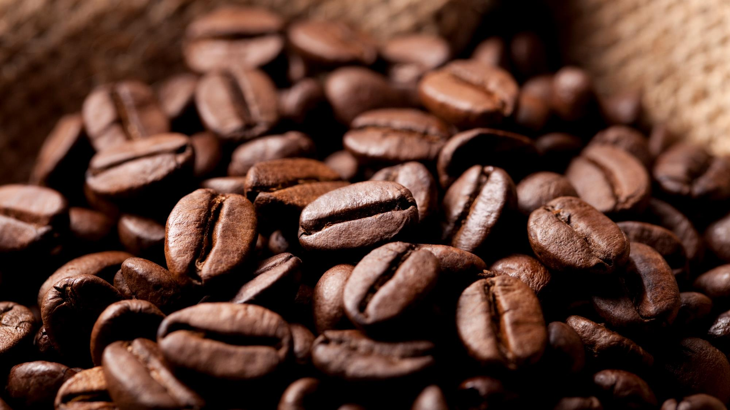
Bright COFFEE SHOP
Sales Analysis for the CEO

Slide 2
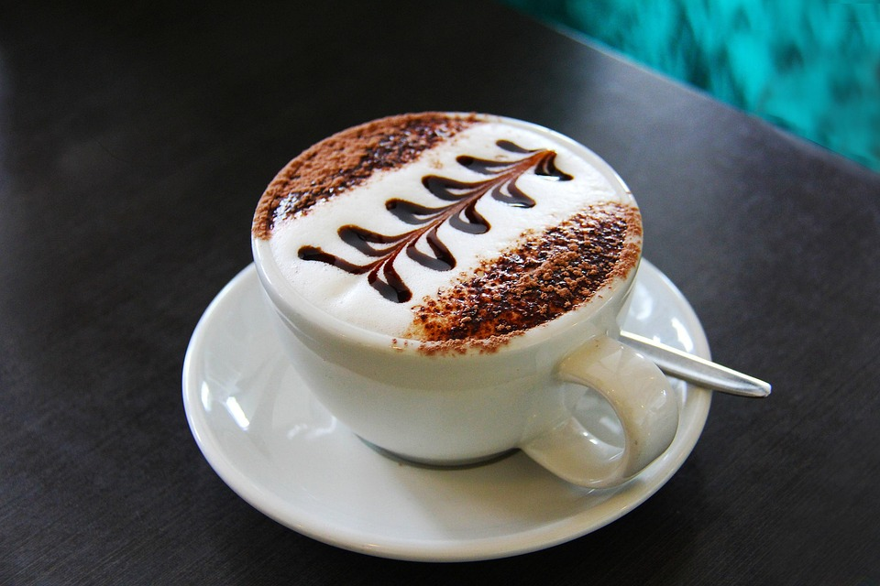
Coffee SHOP ANALYSIS
The data in this presentation is extracted from the Bright Coffee Shop daily transactions for the period January to June.
Purpose Of Analysis:
To provide actionable insights from the historical data that will assist the CEO in decision making

Slide 3
Number of units sold by product category

Slide 4
Number of sales by Month ID and Time Bucket

Slide 5
Top 3 selling products

Slide 6
Most to least selling product by total sales

Slide 7
Morning accounts for majority of the sales – Excellent opportunity for upselling

Slide 8
TOTAL SALES BY SPEND BAND AND TIME BUCKET – REVEALS THAT “HIGH” AND “VERY HIGH” SPENDERS SHOW UP IN THE MORNING AND ALLOWS US TO MAXIMIZE PROFIT
LOW AND MEDIUM SPENDERS SHOW UP IN THE AFTERNOON AND EVENING – DURING THIS TIME WE CAN OFFER “TO GO PRODUCTS”

Slide 9
SPEND BAND BY LOCATION
Very High Spenders – Lower Manhattan
High –Astoria
Medium – Astoria
Low - Astoria

Slide 10

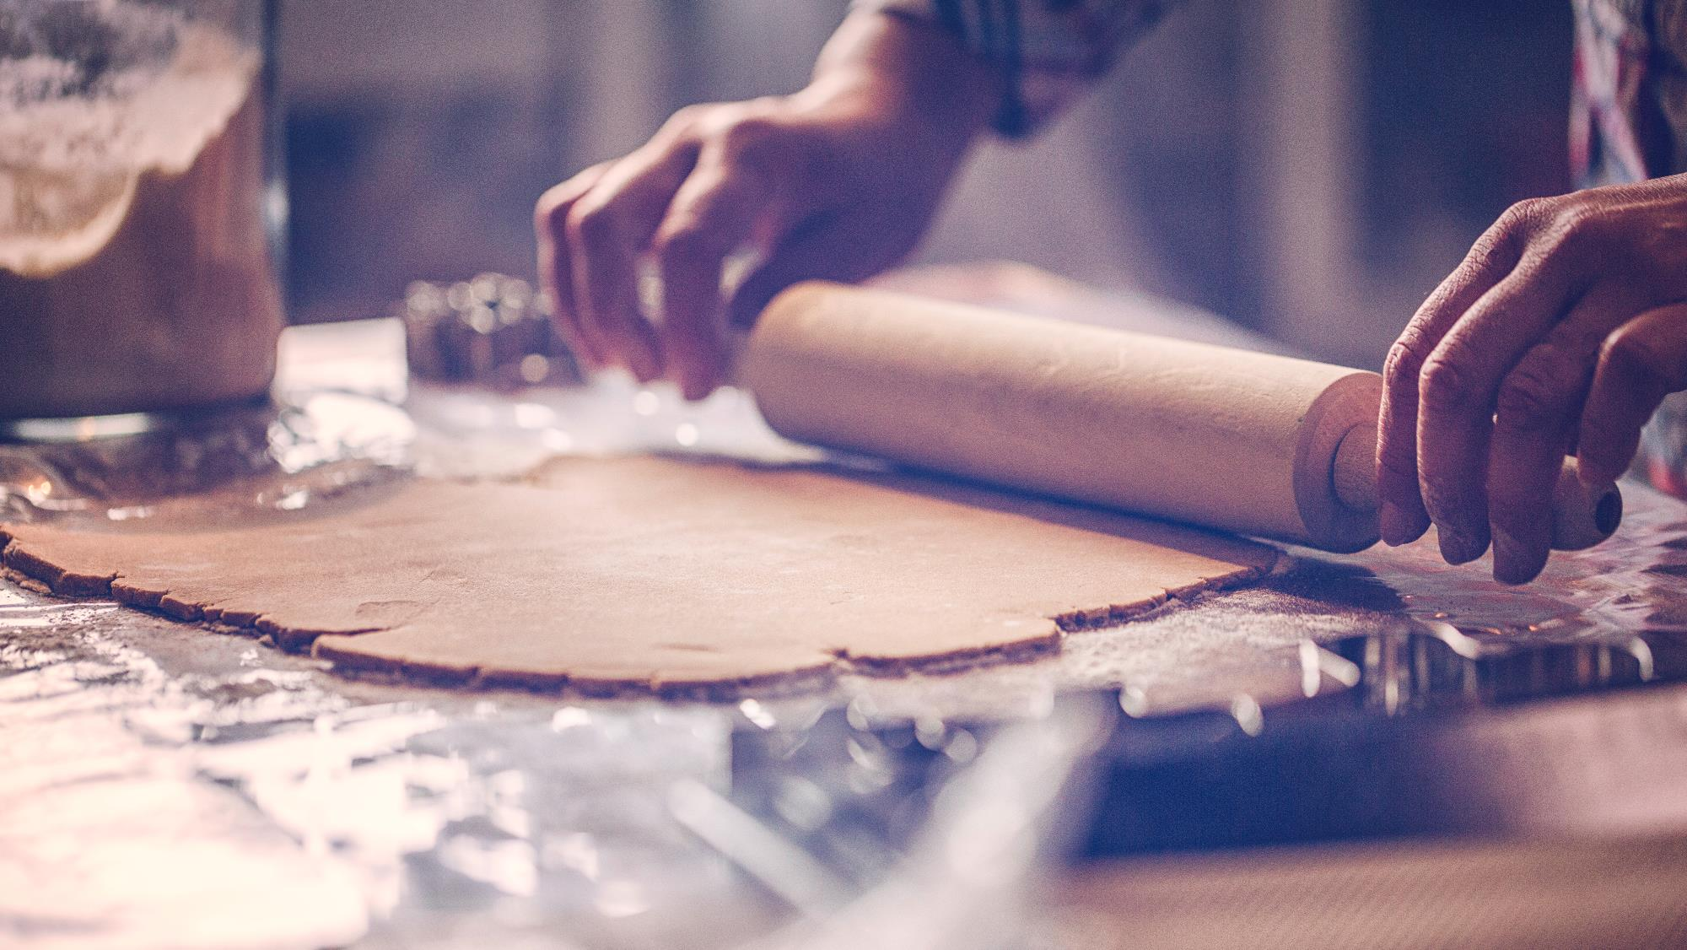
Insights Summary
Bright Light Coffee Shop Analysis: Insights
Sales Performance by Product Category
Coffee is the highest-selling product, followed by tea and bakery items. We should focus on marketing our top-selling coffee products, such as Chai Lattes and Cappuccinos, to align with customer preferences.
Monthly Sales Trends
Sales are particularly high in the mornings during June. Given this demand, there is no need to offer specials or discounts during this period. Conversely, January experiences lower sales. To maximize revenue during this month, we can introduce combo deals, such as pairing a coffee with a bakery item (e.g., a cappuccino with the cake of the day) at a discount of R5 off the normal total price. This approach not only boosts hot beverage sales but also promotes our bakery offerings.
Sales Patterns by Time of Day
The majority of sales occur in the morning, presenting an excellent opportunity for upselling. We have identified two groups of customers: high spenders and low to medium spenders. Since our high to very high spenders frequent the shop in the morning, we should refrain from offering specials during that time. Instead, we can offer "to-go" products in the afternoons and evenings.
Customer Preferences by Location
It's essential to stock items based on customer preferences. For high spenders who favour Frappés, milkshakes, and croissants, we should ensure we have ample stock of these items. For low spenders who prefer simpler options, such as cappuccinos or flat whites along with doughnuts, we need to stock more of those ingredients as well.

Slide 11
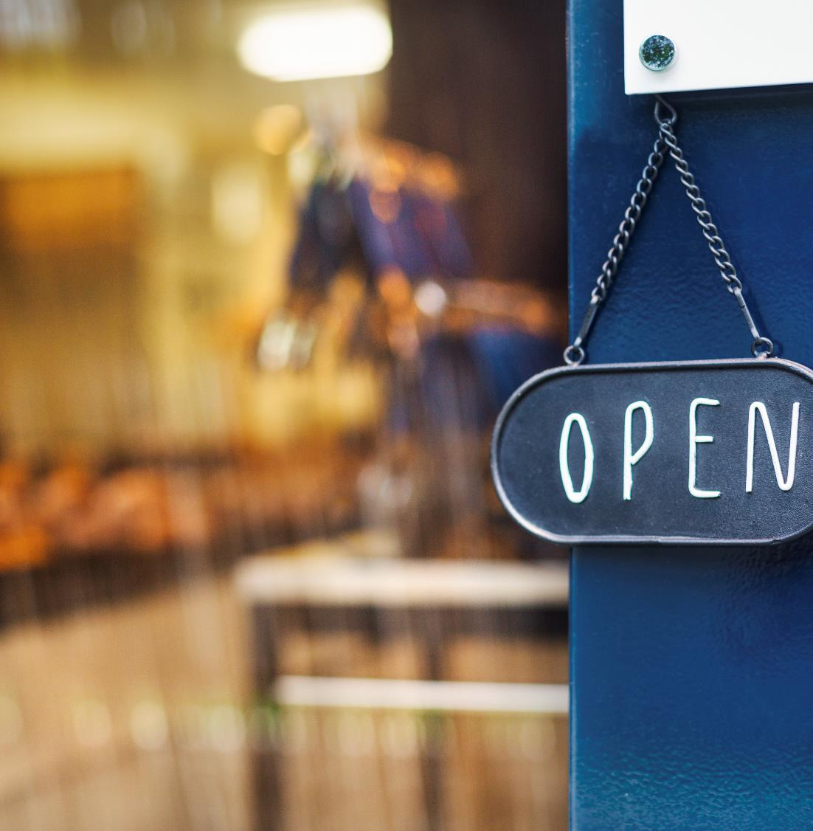

Thank You
Email preciousdl07@gmail.com.com

